Slide 1


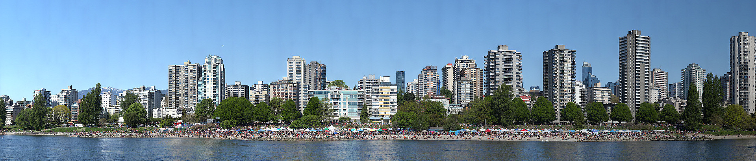

Gigapixel, terapixel
by Kosimov Nodirbek

Slide 2
Contents
Self Introduction
Research Topic
Gigapixel
Terapixel
Topaz Gigapixel AI
Result

Slide 3

Self introduction
Kosimov Nodirbek | 25 years young | from Uzbekistan
Bachelor degree: Ferghana Polytechnic Institute, Uzbekistan, Machine Engineering 2013 - 2017
Master Degree: Dongseo University, Korea, Ubiquitous IT 2018 - current

Slide 4
Research topic
Advisor - Professor Lee Byung Gook
Research area - Computer Vision, Human Pose Recognition & Estimation,
Interested topic - Deep Learning, Computer Graphics

Slide 5
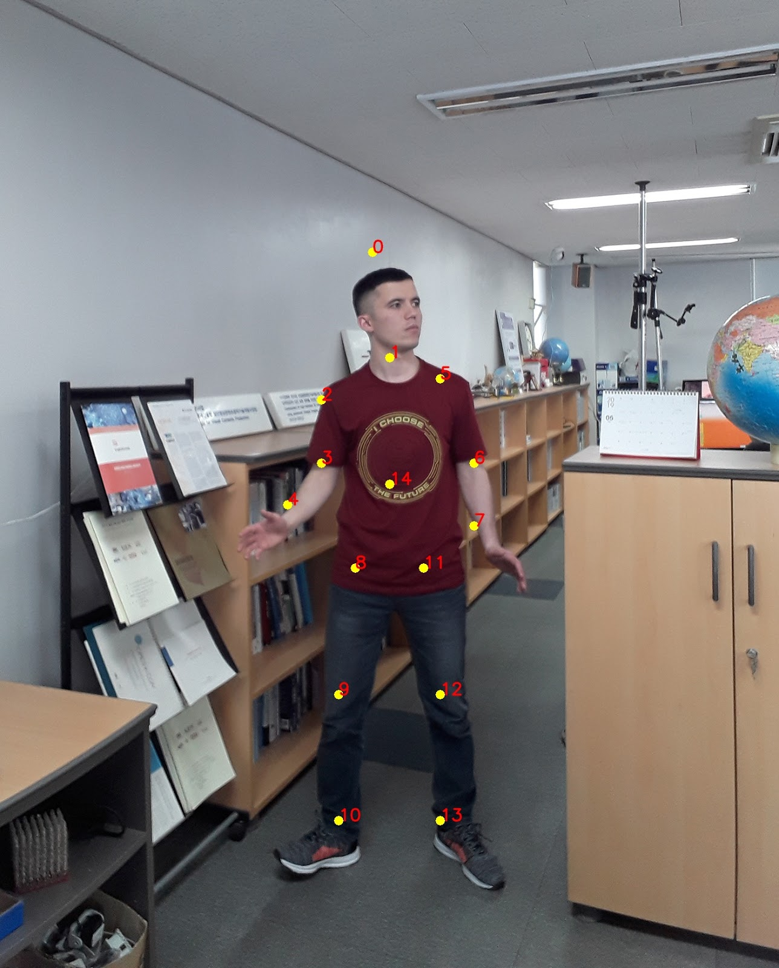
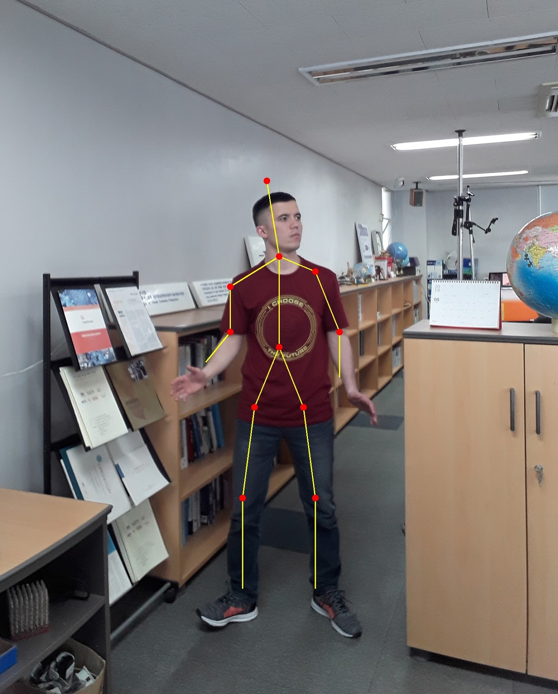
Research topic
Deep Learning based Human Pose Estimation using OpenCV
Pose Estimation is a general problem in Computer Vision where we detect the position and orientation of an object.
This usually means detecting key point locations that describe the object.
For example, in the problem of face pose estimation we detect landmarks on a human face.

Slide 6
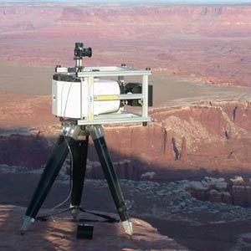
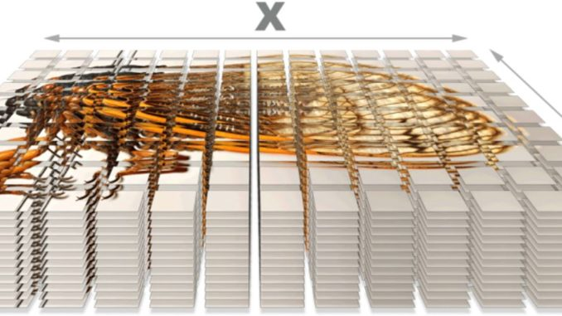
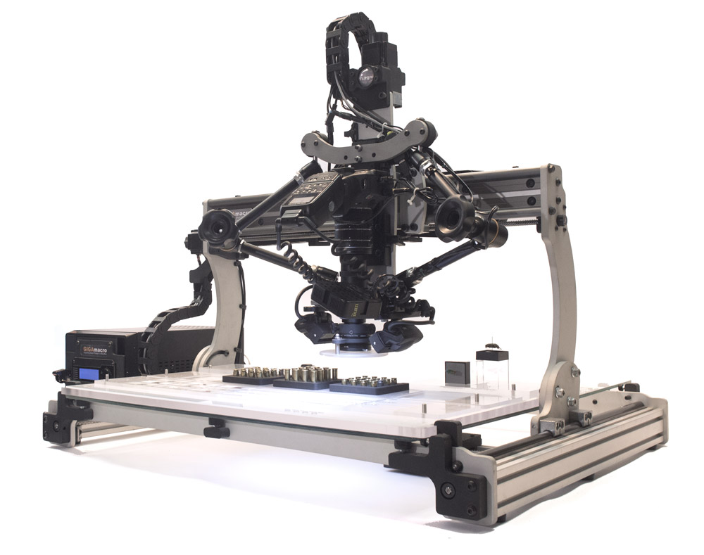
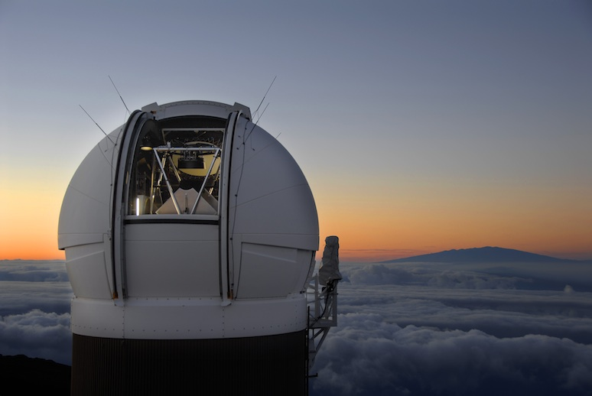
Gigapixel
~ What is gigapixel image?
A gigapixel image is a digital image bitmap composed of one billion (10⁹) pixels (picture elements), 1000 times the information captured by a 1 megapixel digital camera.
For creating such very high-resolution images:
- making mosaics of a large number of high-resolution digital photographs
- using a film negative as large as 12" × 9" (30 cm × 23 cm) up to 18" × 9" (46 cm × 23 cm)
- only few cameras capable: Pan-STARRS PS1 and Gigapixel Camera
A gigamacro image is a gigapixel image which is a close-up or macro image

Slide 7

Gigapixel

Slide 8
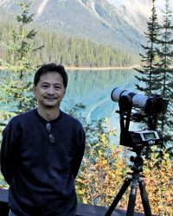
Gigapixel.com
Create stunning gigapixel photos 100 times the information captured by a 10 megapixel camera.
Gigapixel Photography for Various Events
360° Virtual Tours
Sales, Marketing & Promotions
Sports, Concerts, Shows, Events
Visual Effects for TV & Film
Gigapixel Photo Licensing
Custom Installations and Engineering of Fully Remote-Controlled Gigapixel Panoramic Camera Systems
Ronnie Miranda Founder, Gigapixel 360° Photographer

Slide 9
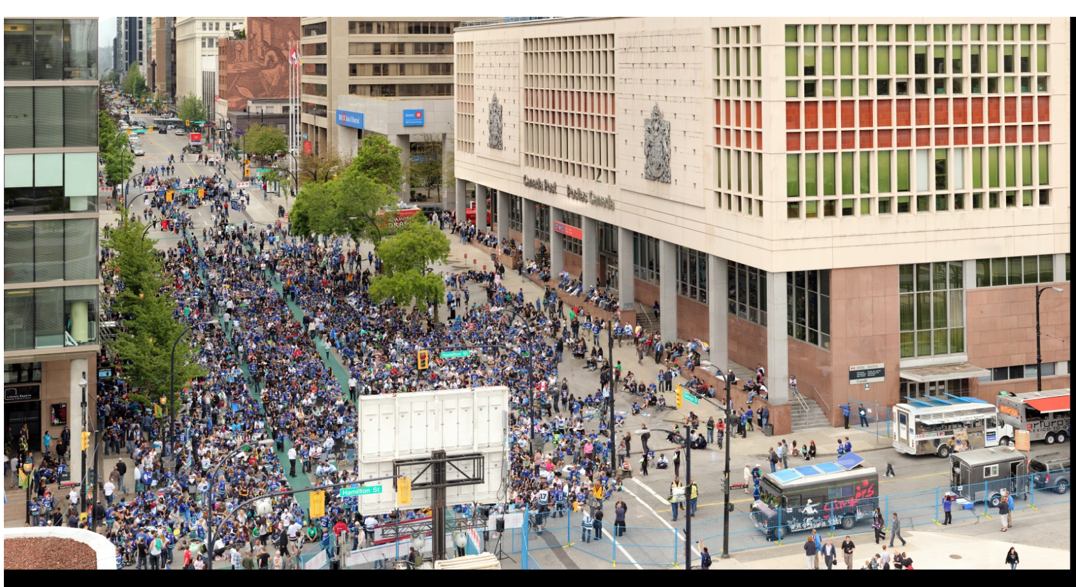
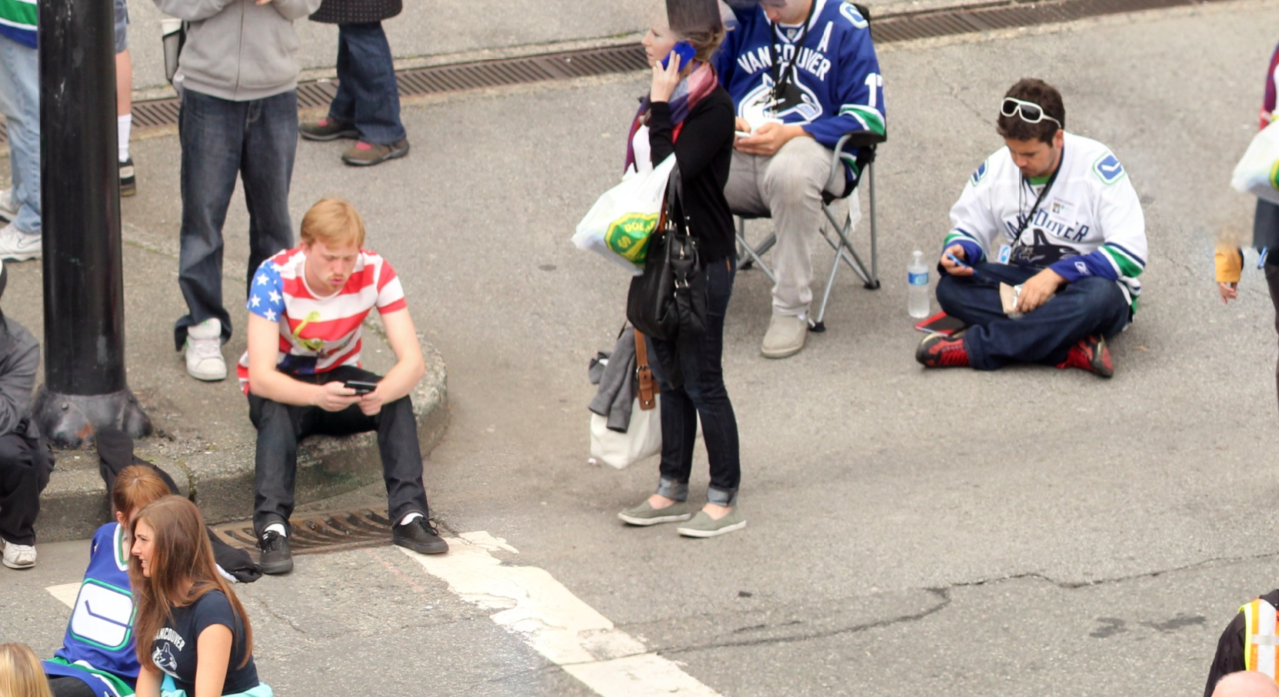
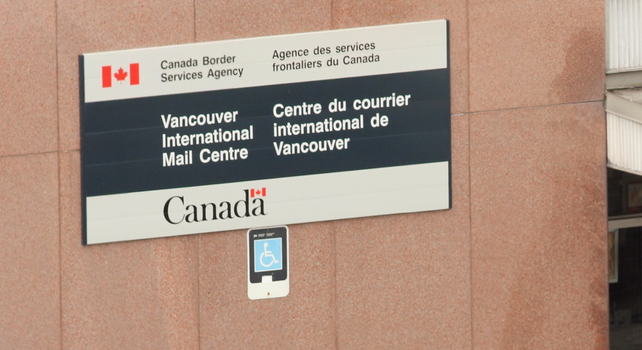
Gigapixel.com
Game 5 Canucks Fan Zone
North View (Jun 2011)
1.51 gigapixels
(1,507 megapixels)

Slide 10
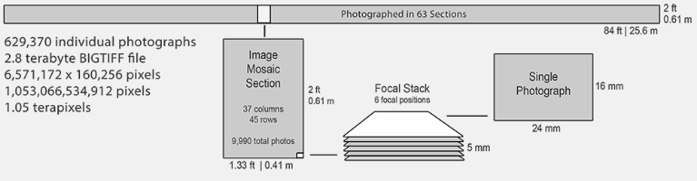
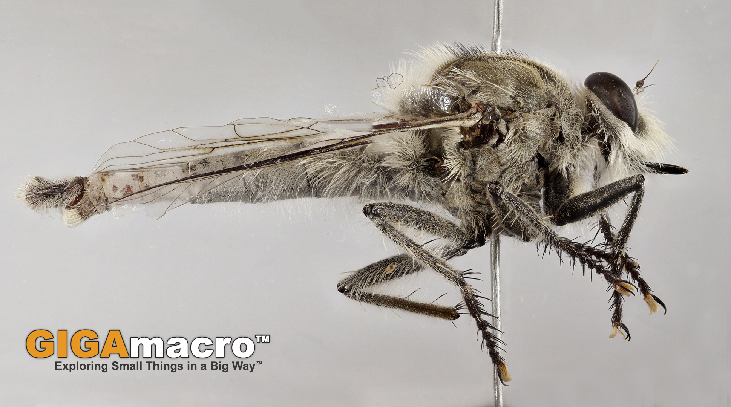
Terapixel
A terapixel image is an image composed of one trillion (10¹²) pixels.
~ the Microsoft Research Terapixel project for use on the Fulldome projection system;
~ a composite of medical images by Aperio;
~ Google Earth's Landsat images viewable as a time-lapse are collectively considered over one terapixel

Slide 11



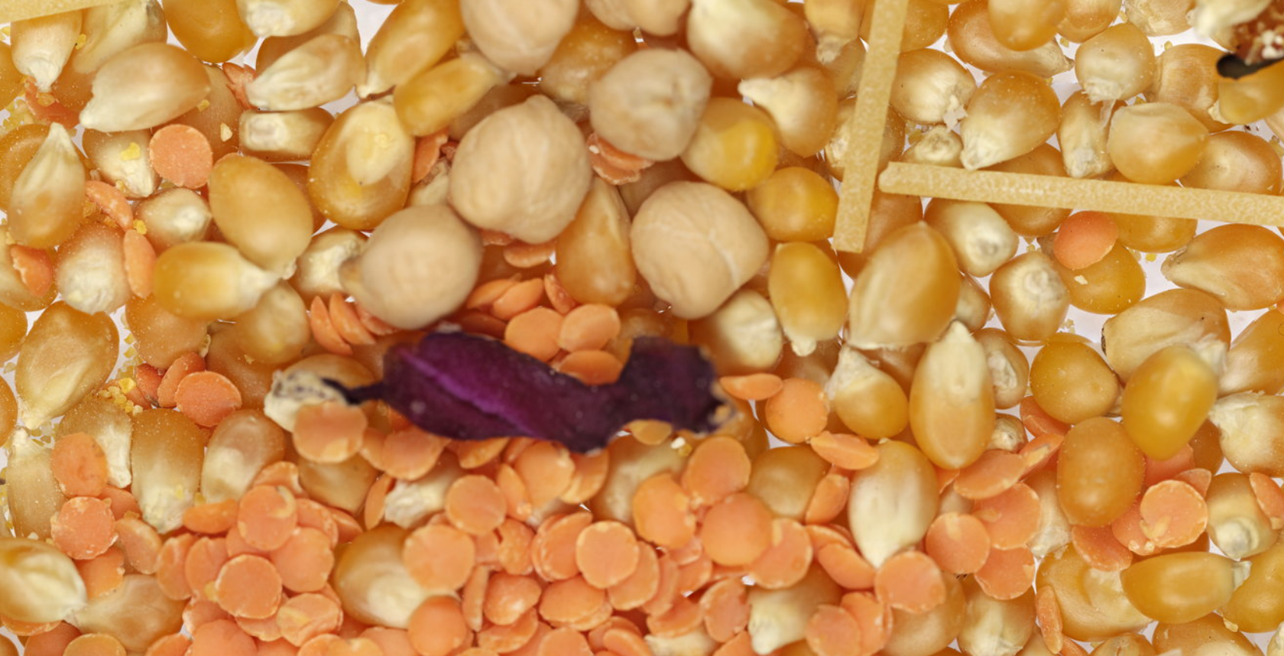
Terapixel
Terabite: World's First Terapixel Macro Photograph - 1053.07 gigapixels

Slide 12
THANK YOU!

